Slide 1
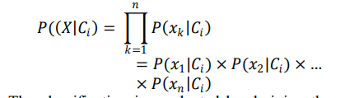
PAPER 1 A SMART SYSTEM FOR FAKE NEWS DETECTION USING MACHINE LEARNING
The news websites are publishing the news and provide the source of authentication .It is harmful for the society to believe on the rumors and pretend to be a news. The need is to stop the rumors , and focus on the correct, authenticated news articles. Most of the smart phone users prefer to read the news through social media over internet. But there is an issue that is authentication of the news and articles which get circulated among social media like WhatsApp groups, Facebook Pages, Twitter and other micro blogs & social networking sites. In this paper the proposed model is working well and defining the correctness of results upto 93.6% of accuracy. the proposed strategy is a mix of Naive Bayes classifier, Support Vector Machines, and semantic investigation.
1)Naive Bayes classifier is a supervised machine learning algorithm that uses Bayes theorem.
2) SVM algorithm is used to extract the binary class based on the data given to the model. In the proposed model, the work is to classify the article in two categories either true or false. A Support Vector Machine (SVM) is a supervised machine learning algorithm that can be used for both regression and classification purpose.

Slide 2
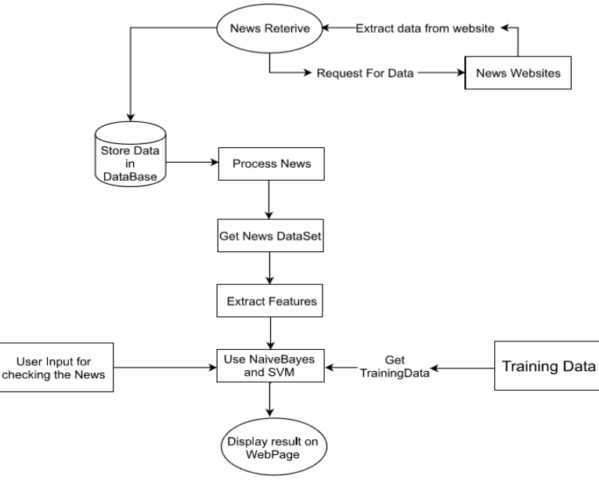

Slide 3
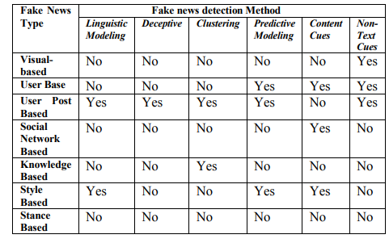
PAPER 2
Fake News Detection Using Machine Learning approaches: A systematic Review
This paper is aimed to provide an effective solution for detecting the fake news or tweets that circulates on social media .so an efficient solution is required for visualizing the text and evaluating whether the article or post is authentic or not. Binary classification is done for checking the accuracy .Every tweet/post is classified as binary classification problem the classification is on the basis of source of the post/tweet. t. The Authors uses manually collected data sets using twitter API , DMOZ and uses 1)Naïve Bayes 2. Descision trees 3. SVM 4. Nueral Networks 5. Random Forest 6. XG Boost algorithm over the data sets
Fake news type
1)Visual based
2)User based
3)Knowledge based
4)Style based

Slide 4
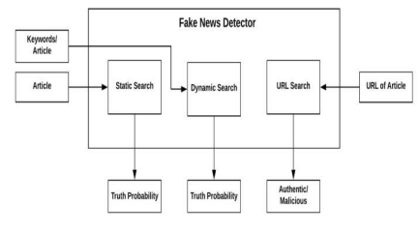
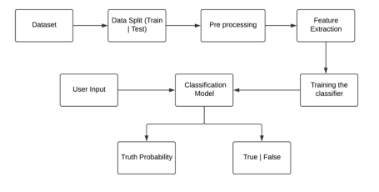
PAPER 3 Fake News Detection using Machine Learning Algorithms Uma Sharma, Sidarth Saran, Shankar M. Patil Department of Information Technology Bharati Vidyapeeth College of Engineering Navi Mumbai, India
This paper explains the system which is developed in three parts. The first part is static which works on machine learning classifier. The second part is dynamic which takes the keyword/text from user and searches online for the truth probability of the news. The third part provides the authenticity of the URL input by user . In this paper the implementation of model is done by Python and its Sci-kit libraries .Django is used for the web based deployment of the model, provides client side implementation using HTML, CSS and Javascript.
1)Static Search
2)Dynamic Search
3)URL Search

Slide 5
PAPER 4 Text Classification using Association Rule with a Hybrid Concept of Naive Bayes Classifier and Genetic Algorithm
Now a day the demand of text classification is increasing tremendously .Text classification is the automated assignment of natural language texts to predefined categories based on their content. The experimental results show that the proposed system works as a successful text classifier. A system based on the proposed algorithm has been implemented and tested. This paper presents a new algorithm for text classification. Instead of using words, word relation i.e association rules is used to derive feature set from pre-classified text documents. Keeping this demand into consideration, new and updated techniques are being developed for the purpose of automated text classification. The concept of Naive Bayes Classifier is then used on derived features and finally a concept of Genetic Algorithm has been added for final classification

Slide 6
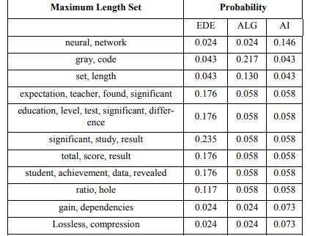

Slide 7
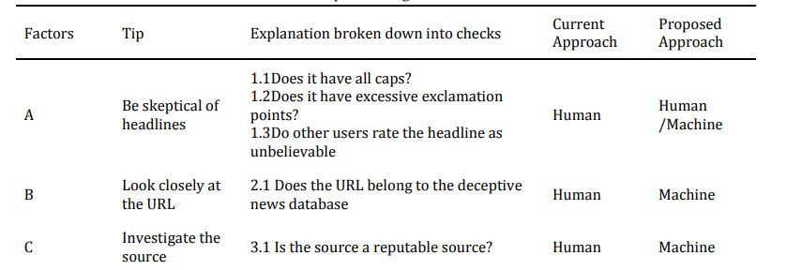
PAPER 5 A HYBRID APPROACH TO FAKE NEWS DETECTION ON SOCIAL MEDIA
In order to solve the issue of fake news detection, various solutions have been proposed and they can be divided into machine-based and human-based solutions. research has drawn us to the limitations of both approaches from human literacy and cognitive limitations to machine learning limitations. It is common knowledge that the benefits of a hybrid model supersede the benefits and functions of its individual components. This paper propose a hybrid model of both the human-based and machine-based approaches. To do this, they combine the human-based social media news literacy education tool and the machine-based approaches for linguistic and network analyses.

